Slide 1
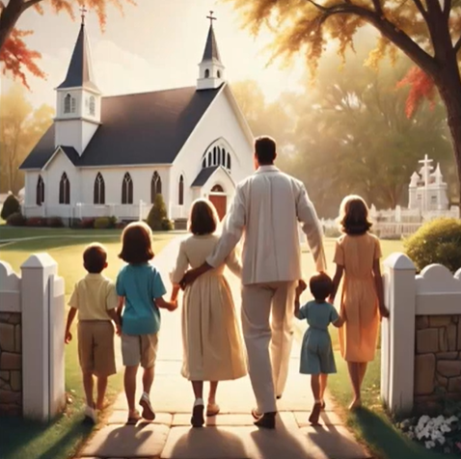
Don’t
Forget
The
Sabbath
#
388

Slide 2

Don’t forget the Sabbath,
The Lord our God hath blest,
Of all the week the brightest,
Of all the week the best;

Slide 3
It brings repose from labour,
It tells of joy divine,
Its beams of light descending,
With heavenly beauty shine

Slide 4
Welcome, welcome, ever welcome,
Blessed Sabbath day,
Welcome, welcome, ever welcome,
Blessed Sabbath day.

Slide 5
Keep the Sabbath holy,
And worship Him today,
Who said to His disciples,
“I am the living way;”

Slide 6
And if we meekly follow
Our Saviour here below,
He’ll give us of the fountain
Whose streams eternal flow.

Slide 7
Welcome, welcome, ever welcome,
Blessed Sabbath day,
Welcome, welcome, ever welcome,
Blessed Sabbath day.

Slide 8
Day of sacred pleasure!
Its golden hours we’ll spend
In thankful hymns to Jesus,
The children’s dearest Friend;

Slide 9
O gentle loving, Saviour,
How good and kind Thou art,
How precious is Thy promise
To dwell in every heart!

Slide 10
Welcome, welcome, ever welcome,
Blessed Sabbath day,
Welcome, welcome, ever welcome,
Blessed Sabbath day.
end

Slide 11
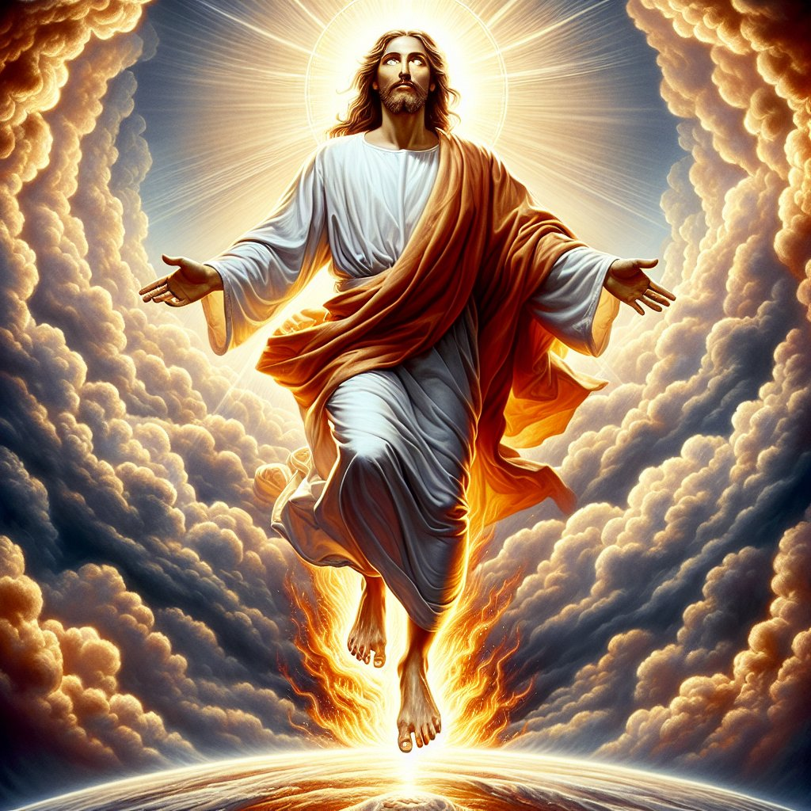
Hail Him the King of Glory
#
202

Slide 12

Tell it to every kindred and nation,
Tell it far and near;
Earth’s darkest night will fade with the dawning,
Jesus will soon appear.

Slide 13
Hail Him the King of glory,
Once the Lamb for sinners slain;
Tell, tell the wondrous story,
“Jesus comes to reign.”

Slide 14
Nations again in strife and commotion,
Warnings by the way;
Signs in the heavens, unerring omens,
Herald the glorious day.

Slide 15
Hail Him the King of glory,
Once the Lamb for sinners slain;
Tell, tell the wondrous story,
“Jesus comes to reign.”

Slide 16
Children of God look up with rejoicing;
Shout and sing His praise;
Blessed are they who, waiting and watching,
Look for the dawning rays.

Slide 17
Hail Him the King of glory,
Once the Lamb for sinners slain;
Tell, tell the wondrous story,
“Jesus comes to reign.”
End

Slide 18
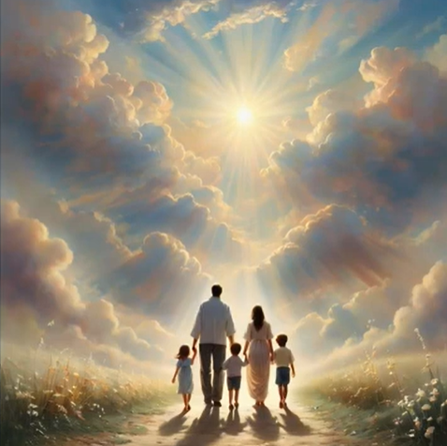
In a Little
While
We’re
Going
Home
#
626

Slide 19
Let us sing a song that will cheer us by the way,
In a little while we’re going home.
For the night will end in the everlasting day,
In a little while we’re going home.

Slide 20
In a little while, In a little while,
We shall cross the billow’s foam;
We shall meet at last, When the stormy winds are past,
In a little while we’re going home.

Slide 21
We will do the work that our hands may find to do,
In a little while we’re going home.
And the grace of God will our daily strength renew,
In a little while we’re going home.

Slide 22
In a little while, In a little while,
We shall cross the billow’s foam;
We shall meet at last, When the stormy winds are past,
In a little while we’re going home.

Slide 23
We will smooth the path for some weary, wayworn feet,
In a little while we’re going home.
And may loving hearts spread around an influence sweet!
In a little while we’re going home.

Slide 24
In a little while, In a little while,
We shall cross the billow’s foam;
We shall meet at last, When the stormy winds are past,
In a little while we’re going home.

Slide 25
There’s a rest beyond, there’s relief from every care,
In a little while we’re going home;
And no tears shall fall in that city bright and fair,
In a little while we’re going home.

Slide 26
In a little while, In a little while,
We shall cross the billow’s foam;
We shall meet at last, When the stormy winds are past,
In a little while we’re going home.
end

Slide 27
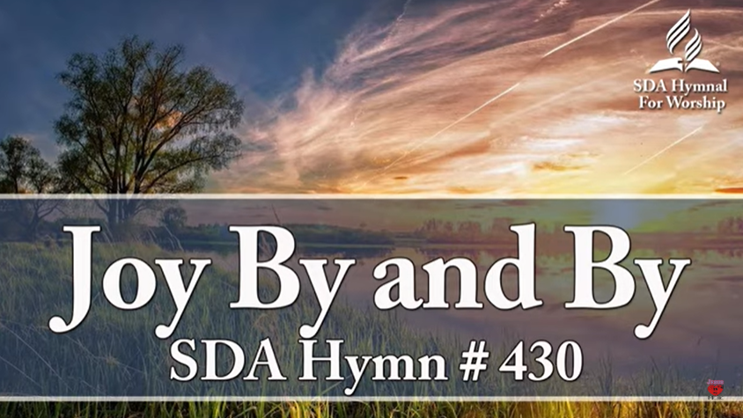


Slide 28
O there’ll be joy when the work is done,
Joy when the reapers gather home,
Bringing the sheaves at set of sun
To the New Jerusalem.

Slide 29
Joy, joy, joy, there’ll be joy by and by,
Joy, joy, joy, where the joys never die;
Joy, joy, joy, for the day draweth nigh
When the workers gather home.

Slide 30
Sweet are the songs that we hope to sing,
Grateful the thanks our hearts shall bring,
Praising forever Christ our King
In the New Jerusalem.

Slide 31
Joy, joy, joy, there’ll be joy by and by,
Joy, joy, joy, where the joys never die;
Joy, joy, joy, for the day draweth nigh
When the workers gather home.

Slide 32
Pure are the joys that await us there,
Many the golden mansions fair;
Jesus Himself doth them prepare,
In the New Jerusalem

Slide 33
Joy, joy, joy, there’ll be joy by and by,
Joy, joy, joy, where the joys never die;
Joy, joy, joy, for the day draweth nigh
When the workers gather home.
end

Slide 34


Slide 35


Slide 36

Holy words long preserved
for our walk in this world,
They resound with God's own heart
Oh, let the ancient words impart

Slide 37
Words of Life, words of hope
Give us strength, help us cope
In this world, where e'er we roam
Ancient words will guide us home

Slide 38
Ancient words ever true
Changing me, and changing you.
We have come with open hearts
Oh let the ancient words impart

Slide 39
Holy words of our Faith
Handed down to this age.
Came to us through sacrifice
Oh heed the faithful words of Christ.

Slide 40
Holy words long preserved
For our walk in this world.
They resound with God's own heart
Oh let the ancient words impart

Slide 41
Ancient words ever true
Changing me, and changing you.
We have come with open hearts
Oh let the ancient words impart

Slide 42
2
Ancient words ever true
Changing me, and changing you.
We have come with open hearts
Oh let the ancient words impart

Slide 43
We have come with open hearts
Oh let the ancient words impart.
end

Slide 44

Invocation

Slide 45

Holy, holy, holy, Holy is the Lord!
Holy, holy, holy, Holy is our God!
He who always liveth, Evermore the same
Heav’n and earth He ruleth, Come and praise His name!

Slide 46


Slide 47

I'll say of the Lord that, He is my refuge
In Him will I put, all of my trust
He's taking me daily
From glory to glory
In Him will I trust
In Him will I trust

Slide 48
Some trust in chariots
Some trust in horses
But I will remember the name of my God
He is a warrior
Yes, He is mighty
In Him will I trust
In Him will I trust

Slide 49
He's my defender, my shield and buckler
My hope is built, firmly on Him
On mountains, in valleys
My God is before me
So in Him will I trust
In Him will I trust

Slide 50
Some trust in chariots
Some trust in horses
But I will remember the name of my God
He is a warrior
Yes, He is mighty
In Him will I trust
In Him will I trust

Slide 51
2
Some trust in chariots
Some trust in horses
But I will remember the name of my God
He is a warrior
Yes, He is mighty
In Him will I trust
In Him will I trust

Slide 52
No one is greater than You,
No one is mightier than You!
No one can love me like You do,
To You hallelujah, hallelujah.

Slide 53
You made the sun, moon and stars,
Sovereign God is who you are
Mighty conqueror in this war,
To You hallelujah, hallelujah.

Slide 54
Hallelujah, My God
Hallelujah, My King
Hallelujah, My Lord
Hallelu, Hallelu

Slide 55
You are the great High Priest,
Mercy and grace You release
You give me perfect peace
To You hallelujah, hallelujah.

Slide 56
Your presence is always around,
Fills me with beautiful sound,
Now I am heavenly bound
To You hallelujah, hallelujah.

Slide 57
Hallelujah, My God
Hallelujah, My King
Hallelujah, My Lord
Hallelu, Hallelu

Slide 58
Hallelujah, My God
Hallelujah, My King
Hallelujah, My Lord
Hallelu, Hallelu
2

Slide 59
You Lord, You are worthy
And no one can worship You for me
For all the things You've done for me
And no one can worship You for me

Slide 60
Here's my worship
All of my worship
Receive my worship
All of my worship

Slide 61
Here's my worship
All of my worship
Receive my worship
All of my worship

Slide 62
You Lord, You are worthy
And no one can worship You for me
For all the things You've done for me
And no one can worship You for me

Slide 63
Here's my worship
All of my worship
Receive my worship
All of my worship

Slide 64
Here's my worship
All of my worship
Receive my worship
All of my worship

Slide 65
And I will not be silent
I will always worship You
As long as I am breathing
I will always worship You

Slide 66
And I will not be silent
I will always worship You
As long as I am breathing
I will always worship You

Slide 67
Here's my worship
All of my worship
Receive my worship
All of my worship

Slide 68
Here's my worship
All of my worship
Receive my worship
All of my worship
2

Slide 69
You Lord,
You are worthy!
end

Slide 71
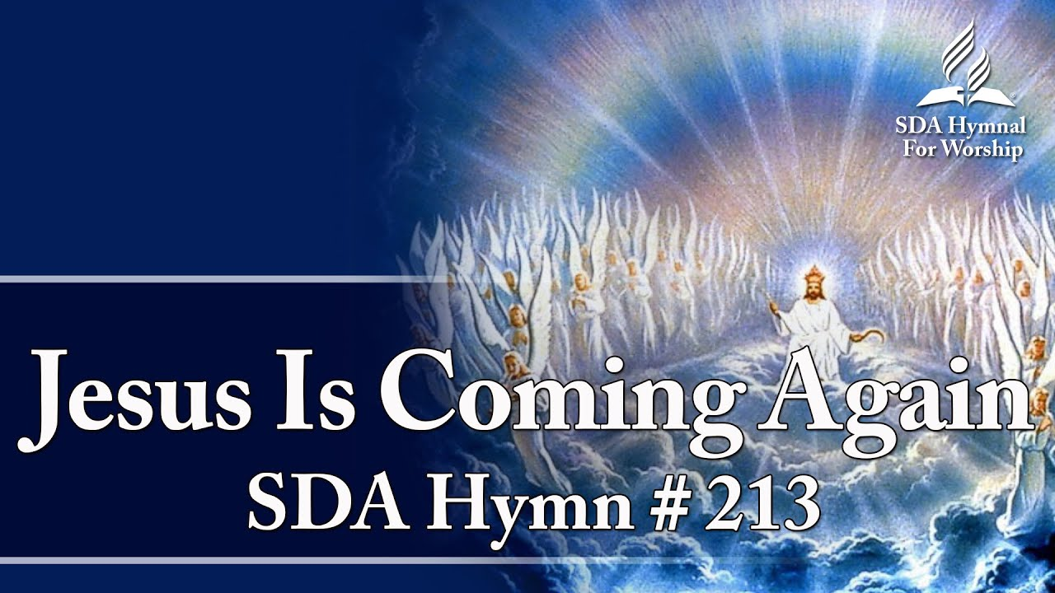

Slide 72

Lift up the trumpet, and loud let it ring:
Jesus is coming again!
Cheer up, ye pilgrims, be joyful and sing:
Jesus is coming again!

Slide 73
Coming again,
Coming again,
Jesus is coming again!

Slide 74
Echo it, hilltops; proclaim it, ye plains:
Jesus is coming again!
Coming in glory, the Lamb that was slain;
Jesus is coming again!

Slide 75
Coming again,
Coming again,
Jesus is coming again!

Slide 76
Heavings of earth, tell the vast, wondering throng:
Jesus is coming again!
Tempests and whirlwinds, the anthem prolong;
Jesus is coming again!

Slide 77
Coming again,
Coming again,
Jesus is coming again!

Slide 78
Nations are angry
By this we do know
Jesus is coming again!
Knowledge increases; men run to and fro;
Jesus is coming again!

Slide 79
Coming again,
Coming again,
Jesus is coming again!
end

Slide 80
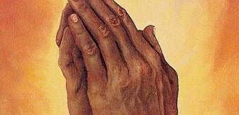
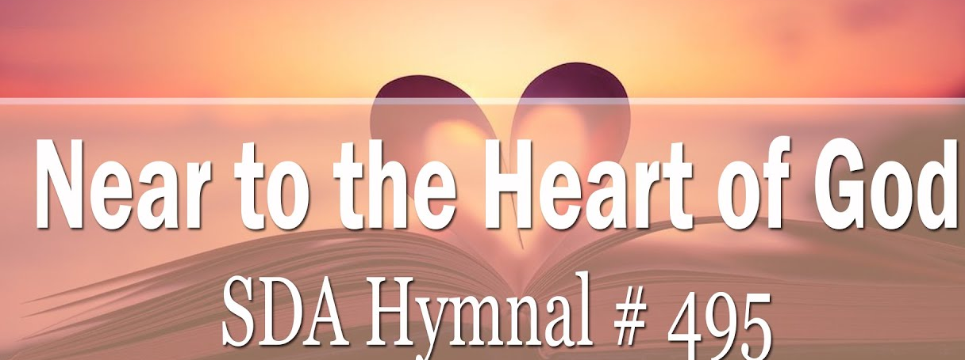
Prayer

Slide 81
There is a place of quiet rest,
Near to the heart of God;
A place where sin cannot molest,
Near to the heart of God.

Slide 82
O Jesus, blest Redeemer,
Sent from the heart of God,
Hold us who wait before Thee
Near to the heart of God.

Slide 83


Slide 84
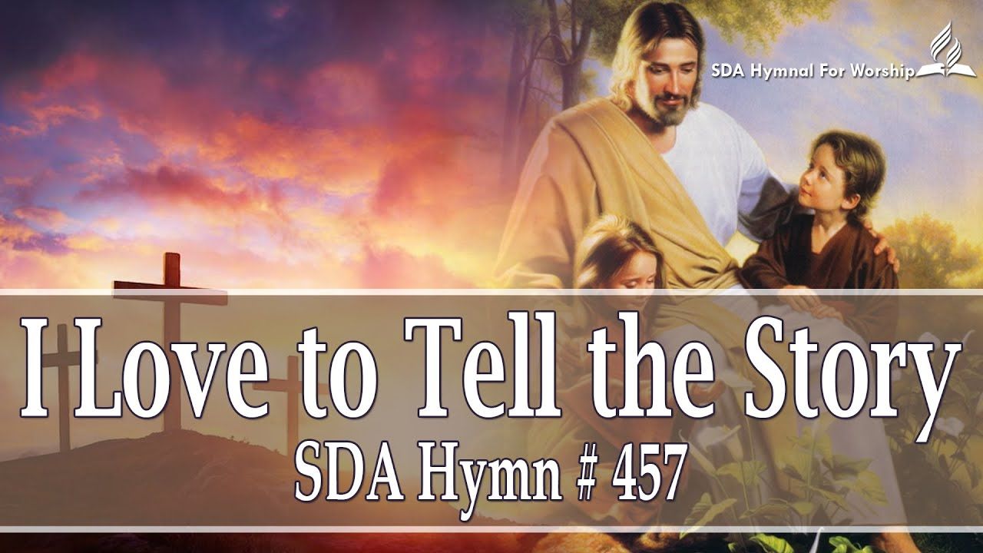

Slide 85

I love to tell the story
Of unseen things above,
Of Jesus and His glory,
Of Jesus and His love;

Slide 86
I love to tell the story,
Because I know 'tis true;
It satisfies my longing
As nothing else can do.

Slide 87
I love to tell the story;
'Twill be my theme in glory
To tell the old, old story
Of Jesus and His love.

Slide 88
I love to tell the story;
More wonderful it seems
Than all the golden fancies
Of all our golden dreams;

Slide 89
I love to tell the story,
It did so much for me,
And that is just the reason
I tell it now to thee.

Slide 90
I love to tell the story;
'Twill be my theme in glory
To tell the old, old story
Of Jesus and His love.

Slide 91
I love to tell the story;
'Tis pleasant to repeat
What seems each time I tell it,
More wonderfully sweet;

Slide 92
I love to tell the story,
For some have never heard
The message of salvation
From God's own holy word.

Slide 93
I love to tell the story;
'Twill be my theme in glory
To tell the old, old story
Of Jesus and His love.

Slide 94
I love to tell the story;
For those who know it best
Seem hungering and thirsting
To hear it like the rest;

Slide 95
And when in scenes of glory
I sing the new, new song,
'Twill be the old, old story
That I have loved so long.

Slide 96
I love to tell the story;
'Twill be my theme in glory
To tell the old, old story
Of Jesus and His love.
end

Slide 97
Recessional

Slide 98


Slide 99

These are the days of Elijah
Declaring the word of the Lord
And these are the days of Your ser-vant Mo-ses
Righteousness being restored

Slide 100
And though these are days of great trials
Of famine and darkness and sword
Still, we are the voice in the desert crying
"Prepare ye the way of the Lord!"

Slide 101
Behold, He comes riding on the clouds
Shining like the sun, at the trumpet call
Lift your voice, it’s the year of jubilee
And out of Zion's hill, salvation comes

Slide 102
2
Behold, He comes riding on the clouds
Shining like the sun, at the trumpet call
Lift your voice, it’s the year of jubilee
And out of Zion's hill, salvation comes

Slide 103
And these are the days of Ezekiel
The dry bones becoming as flesh,
And these are the days of Your ser-vant David
Rebuilding a temple of praise

Slide 104
And these are the days of the harvest
The fields are as white in Your world
And we are the labourers in Your vineyard
Declaring the word of the Lord!

Slide 105
Behold, He comes riding on the clouds
Shining like the sun, at the trumpet call
Lift your voice, it’s the year of jubilee
And out of Zion's hill, salvation comes

Slide 106
2
Behold, He comes riding on the clouds
Shining like the sun, at the trumpet call
Lift your voice, it’s the year of jubilee
And out of Zion's hill, salvation comes

Slide 107
There’s no God like Jehovah
(x 8)
There’s no God like Jehovah
(x 4)
There’s no God like Jehovah
(x 3)

Slide 108
Behold, He comes riding on the clouds
Shining like the sun, at the trumpet call
Lift your voice, it’s the year of jubilee
And out of Zion's hill, salvation comes

Slide 109
2
Behold, He comes riding on the clouds
Shining like the sun, at the trumpet call
Lift your voice, it’s the year of jubilee
And out of Zion's hill, salvation comes

Slide 110
Lift your voice, it’s the year of jubilee
And out of Zion's hill, salvation comes
Lift your voice, it’s the year of jubilee
And out of Zion's hill, sal-va-tion – comes!
end

